Slide 1
GenEd 1079 - Section 8
Health insurance

Slide 2
Unit Assignment 3 Announcement!
If you would like to request your own group for UA3, you are welcome to submit a group request to your TF by end of lecture on Thursday (11/5/26; 1:15 PM EST). Google form in Janice’s email from Monday.
Groups must be composed of students within your own section.
Janice’s 12pm: Groups of 3-4
Janice’s 1:30pm: Groups of 3
Groups require approval by the TF and are subject to change.

Slide 3
Reminders
Problem Set 3 due Monday 11/9 at 5 pm
  Office hours this week:
    TONIGHT 6-7pm @ Sever 104
    Friday 12:30-2:30pm @ HKS Littauer 332
    Friday 4-5pm @ HKS Littauer 239
Unit Assignment 3 due Tuesday 11/24 at 5 pm
No section the week of Thanksgiving!
Reach out if you have questions about the problem set, Unit Assignment 3, or the final exam

Slide 4
Agenda for Section 8
Review of key health insurance terms
Explore Harvard’s open enrollment guide (~30min)
Calculate costs & choose a plan for Lindsey (~15min)
Notes:
Goal: by the end of section, students can read a plan comparison chart and calculate what a person pays in a year under each plan
Heavier on how an insurance policy works (premiums, deductibles, copays, coinsurance, OOP max)
Lighter on selection stuff (adverse selection, why people pick the plans they do); covered in lecture on 11/24
If time is tight, cut the guide walkthrough short, not the Lindsey exercise

Slide 5
Health insurance terms
Premium: the monthly cost of your health insurance plan.
Deductible: you pay everything out of pocket until you reach this amount.
Coinsurance: the percentage of the total cost that is paid out-of-pocket.
Copay: fixed amount (contrasted with coinsurance, which is a % of a total) paid for certain services.
Out of pocket limit/maximum: the maximum amount you pay out-of-pocket, the plan pays all cost after this amount.
Network: a group of health care providers.
  In-network: a group of providers for which insurer has negotiated cheaper care.
  Out-of-network: all other providers (no agreement for cheaper care)
Notes:
Premium: paid every month whether or not you use any care. E.g., $89/month = $1,068/year
Deductible: e.g., $250 deductible and a $1,400 MRI → you pay the first $250 yourself
Coinsurance: the % you pay after the deductible is met. Same MRI at 10% → 10% of the remaining $1,150 = $115
Copay: flat $ amount regardless of what the service actually costs. $30 copay is $30 whether the visit costs $170 or $320
Copay vs coinsurance: copay = fixed $, coinsurance = % of the bill
OOP max: cap on everything you pay for care in a year (deductible + copays + coinsurance). After you hit it, plan pays 100%
Premiums do NOT count toward the deductible or the OOP max (most common student confusion)
Network: insurer negotiates lower prices with in-network providers; out-of-network = no negotiated price, so you pay more or the plan pays nothing

Slide 6
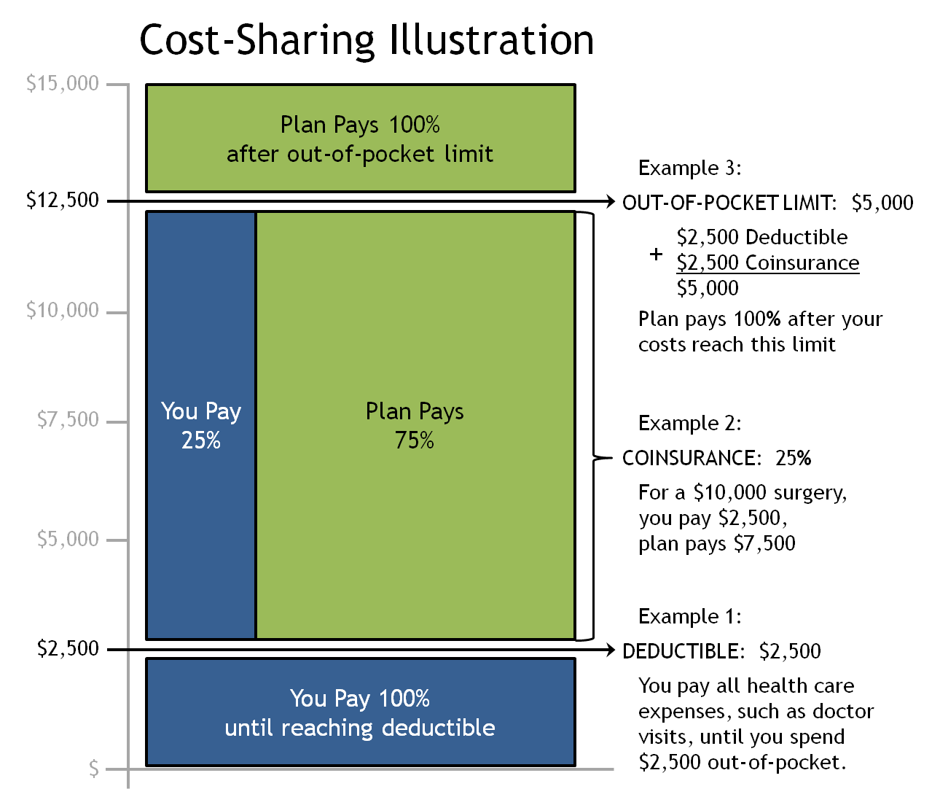
Cost-Sharing Illustration
Green is what the plan pays
Blue is what you pay
Key Terms
Deductible
Coinsurance
Out of pocket limit
IRS definition (2027): a high-deductible health plan has a deductible of at least $1,750 for self-only coverage
Notes:
Y axis: total amount of healthcare expenses that individual incurs (for a year)
Blue: amount you as a patient (consumer pay)
Green: what plan pays
This plan: Deductible for $2500. Coinsurance kicks in once you hit the deductible.
For the spending between 2500 – 12500, you pay 25%
25% of the $10,000 between $2,500 and $12,500 = $2,500
Once you hit 12500, meaning you already spent 5000 ($2,500 deductible + $2,500 coinsurance), you have reached the OOP limit and the plan pays 100% of everything after that
Worked example: $10,000 surgery → you pay $2,500 deductible + 25% of $7,500 ($1,875) = $4,375; plan pays $5,625
Point to make: the OOP limit is what protects you from catastrophic costs; the deductible and coinsurance are what make you price-sensitive (demand-side rationing from lecture)
Note on the red box: IRS sets the minimum deductible for a plan to count as an HDHP ($1,750 self-only in 2027); this example plan would qualify

Slide 7
Agenda for section 8
Review of key health insurance terms
Explore Harvard’s open enrollment guide (~30min)
Calculate costs & choose a plan for Lindsey (~15min)
Notes:
Having defined the terms of health insurance, we will now apply it using Harvard’s employee benefits/health insurance plan as an example.

Slide 8

Notes:
Open enrollment: the once-a-year window when employees choose or change their health plan for the next calendar year
Outside this window, you can only change plans after a qualifying life event (e.g., marriage, having a baby, losing other coverage)
Harvard's 2027 open enrollment: Oct 27 – Nov 5, 2026
This is the Faculty & Nonunion Staff guide from ~2023; union employees have different plans and rates

Slide 9
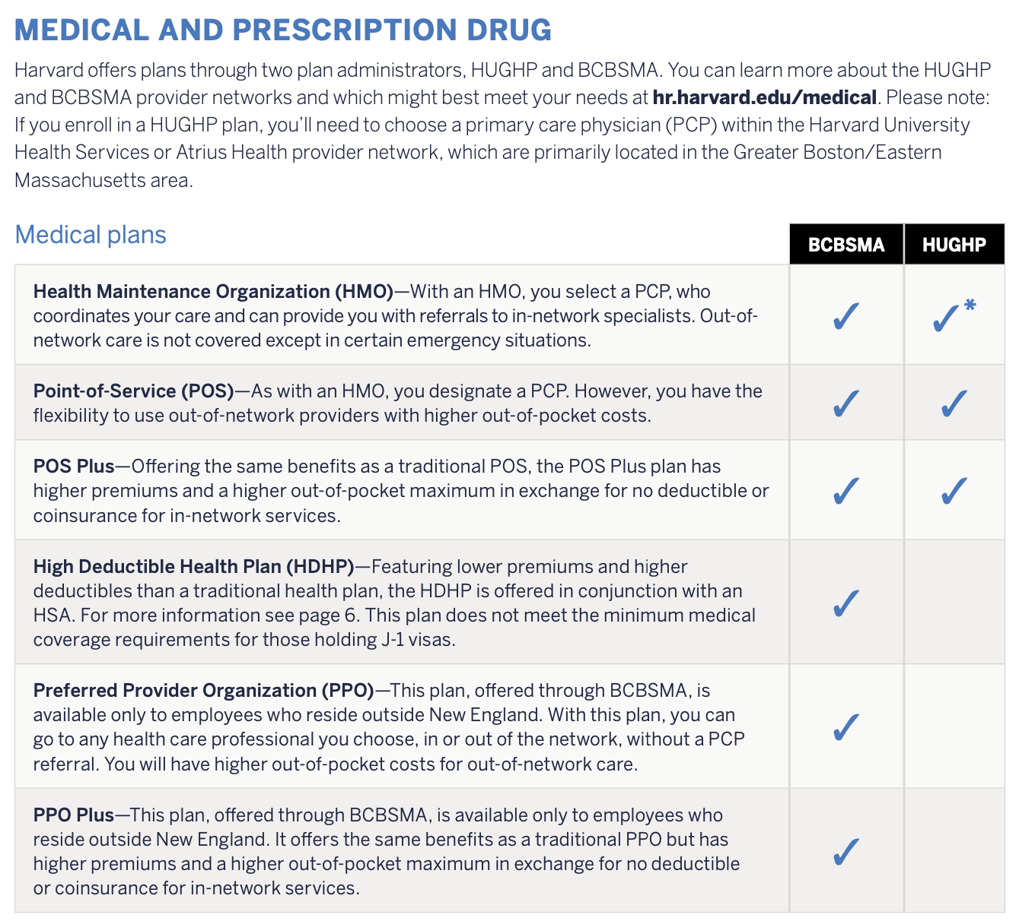
Health Maintenance Organization (HMOs), Point of Service (POS), High Deductible Health Plans (HDHPs)
Key Terms:
Blue Cross Blue Shield of Massachusetts (BCBSMA)
Harvard University Group Health Plan (HUGHP)
Health Maintenance Organization (HMO)
Point-of-Service (POS)
High Deductible Health Plan (HDHP)
Notes:
HMO – low premiums, no out-of-network care, need a PCP (particularly for referrals to specialists).
POS – in between an HMO and PPO; higher premiums, can go to out-of-network care for higher cost-sharing. Still need a PCP assigned as in HMO, but some more flexibility to go out-of-network without a referral
POS Plus – same network as POS, but higher premiums and a higher OOP max in exchange for no deductible or coinsurance in network
HDHP – very low premiums and contribution to an HSA, but higher deductible and OOP maximum.
HDHP only offered through BCBSMA; does not meet coverage requirements for J-1 visa holders
PPO / PPO Plus – no PCP or referrals needed, see anyone in or out of network; only for employees living outside New England
HSA (health savings account): money goes in pre-tax, grows tax-free, and comes out tax-free for medical expenses; rolls over every year and stays with you if you leave Harvard. IRS limit for 2027 is $4,500 self-only. Harvard's contribution: [check 2027 guide]
BCBSMA vs HUGHP: same types of plans, two different administrators
HUGHP – Harvard's own plan; your adult PCP must be at Harvard University Health Services or Atrius Health; specialists come from the BCBS HMO Blue network. Narrower PCP network → lower premiums
BCBSMA – much larger network of PCPs; higher premiums
Discussion question (can skip depending on time): why would a narrower network let a plan charge less?
Reasonable answers: The plan can promise each provider a large share of its members (leverage), with providers accepting lower prices in exchange for that guaranteed volume.
HUGHP’s PCPs are at HUHS or Atrius, so the plan has more say over referrals, testing, and which specialists patients see.
A plan with fewer choices tends to attract people who don’t have strong ties to a particular doctor, and those people are often healthier.

Slide 10
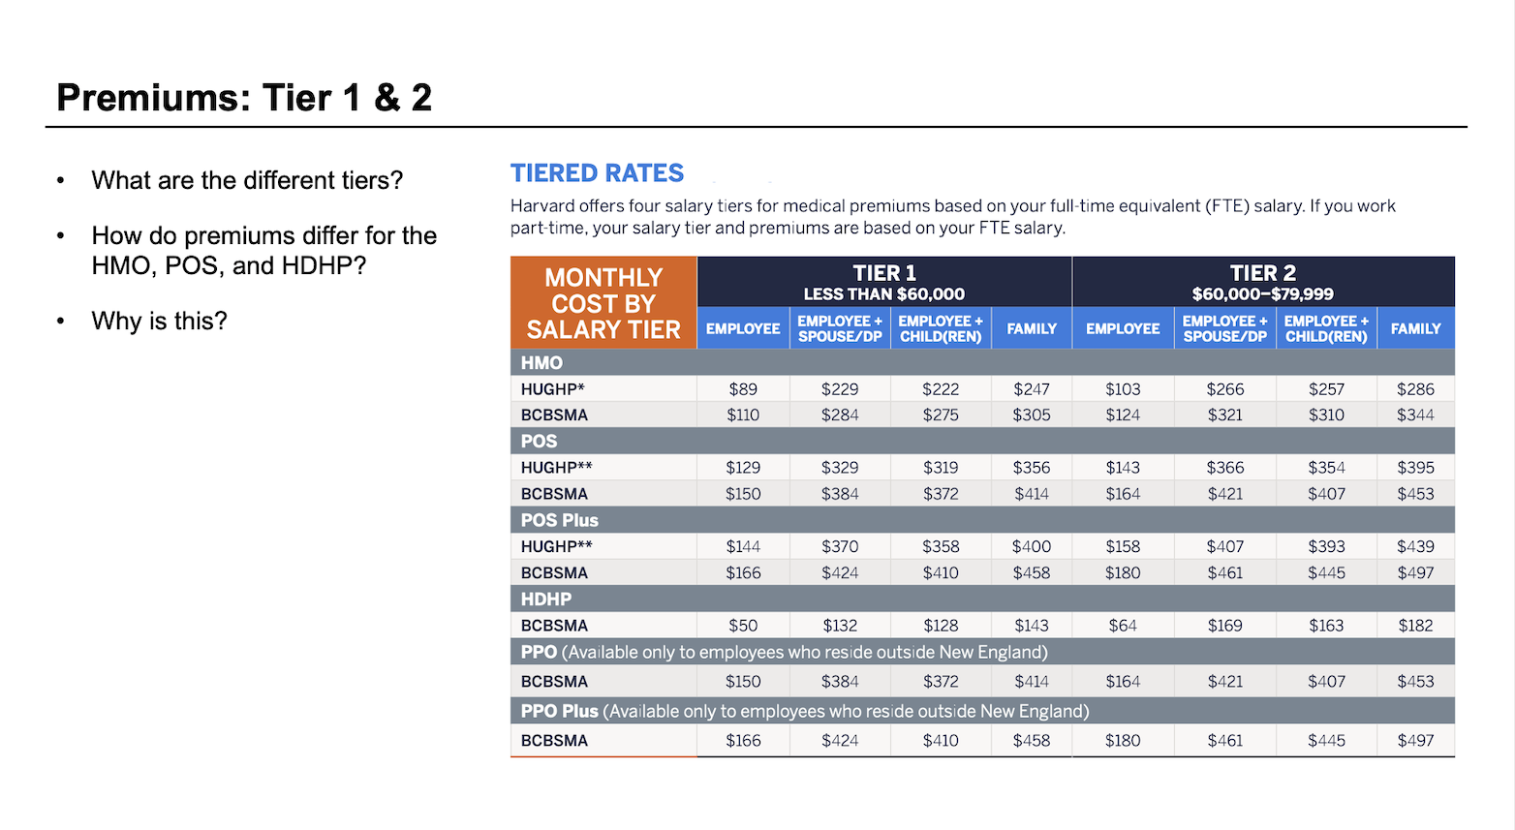
Notes:
These are monthly premiums the employee pays based on their salary, with Harvard paying the rest of the cost of the plan
Four salary tiers based on full-time equivalent (FTE) salary: Tier 1 under $60,000, Tier 2 $60,000–$79,999
Coverage level across the columns: employee only, + spouse/domestic partner, + child(ren), family
Q: How do premiums differ? Cheapest to most expensive: HDHP < HMO < POS < POS Plus
Q: Why is this? Premium tracks how much the plan is expected to pay out
HDHP: you pay much more before the plan pays → cheapest
HMO: no out-of-network coverage, referrals required → cheaper
POS: adds out-of-network option → more expensive
POS Plus: no deductible or coinsurance in network → most expensive
HUGHP cheaper than BCBSMA for the same plan type because of its narrower PCP network
HDHP = much lower monthly cost, same with HMO
[for the case example later on] Lindsey earns $53,000 → Tier 1, employee only column

Slide 11
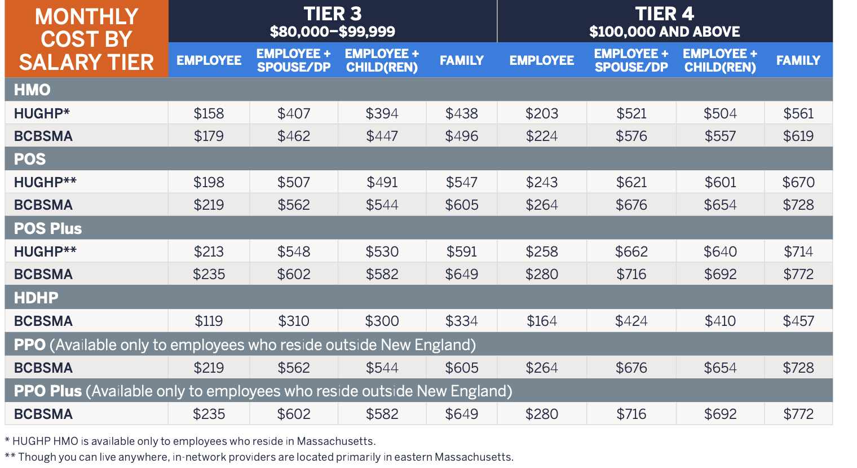
Premiums: Tier 3 & 4
What are the different tiers?
How do premiums differ for the HMO, POS, and HDHP?
Why is this?
Notes:
Tier 3 $80,000–$99,999; Tier 4 $100,000 and above
Q: What are the different tiers? Identical plans/coverage, but different prices depending on salary
Same HUGHP HMO, employee only: $89/month in Tier 1 vs $203/month in Tier 4
HDHP: $50/month in Tier 1 vs $164/month in Tier 4
Why is this? Harvard chooses to subsidize lower earners more; premiums take up a similar share of income across tiers instead of being a flat dollar amount

Slide 12
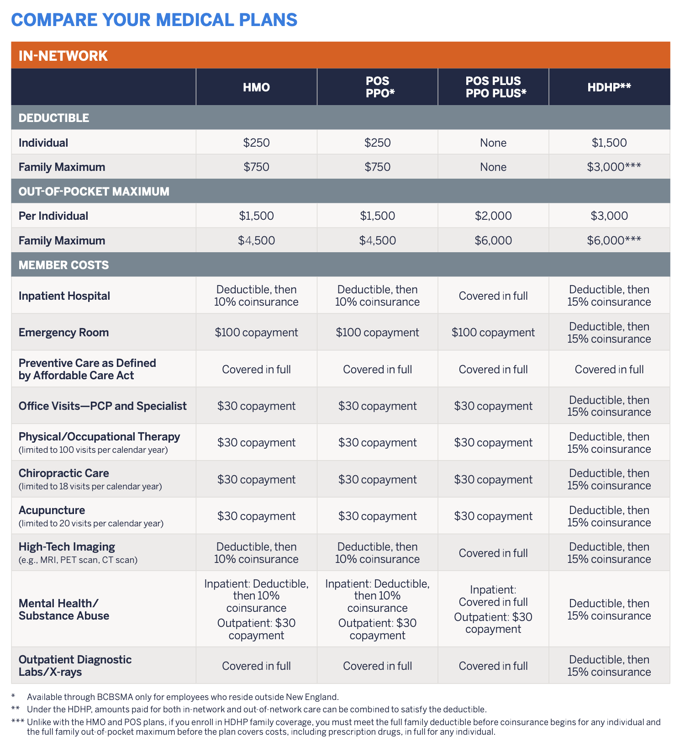
Cost Sharing Details: In Network
Key Terms:
Deductible
Out of Pocket (OOP) Max
Copay
Coinsurance
Deductible then X% Coinsurance
Inpatient vs Outpatient
Notes:
What “Deductible then X% coinsurance” means: If you have not yet met your deductible, then you pay out of pocket while the costs apply towards your deductible. Once you meet your deductible, you pay X% coinsurance on the total amount minus whatever has already contributed towards your deductible.
Services with a copay (office visits, PT) cost the flat copay right away; you don't have to meet the deductible first
HMO and POS have identical in-network cost sharing; only difference is premium and out-of-network access
POS Plus: no deductible, mostly copays or covered in full
HDHP: almost everything is "deductible, then 15% coinsurance," including office visits; only preventive care is free from day one
Preventive care covered in full in every plan (ACA requirement)
Inpatient vs. outpatient: Being admitted to a hospital and potentially overnight stays; outpatient is generally care received where you don’t need to stay overnight in a hospital (like PCP visits or in-office procedures)
HDHP family coverage: must meet the FULL family deductible before coinsurance starts for anyone (unlike HMO/POS)

Slide 13
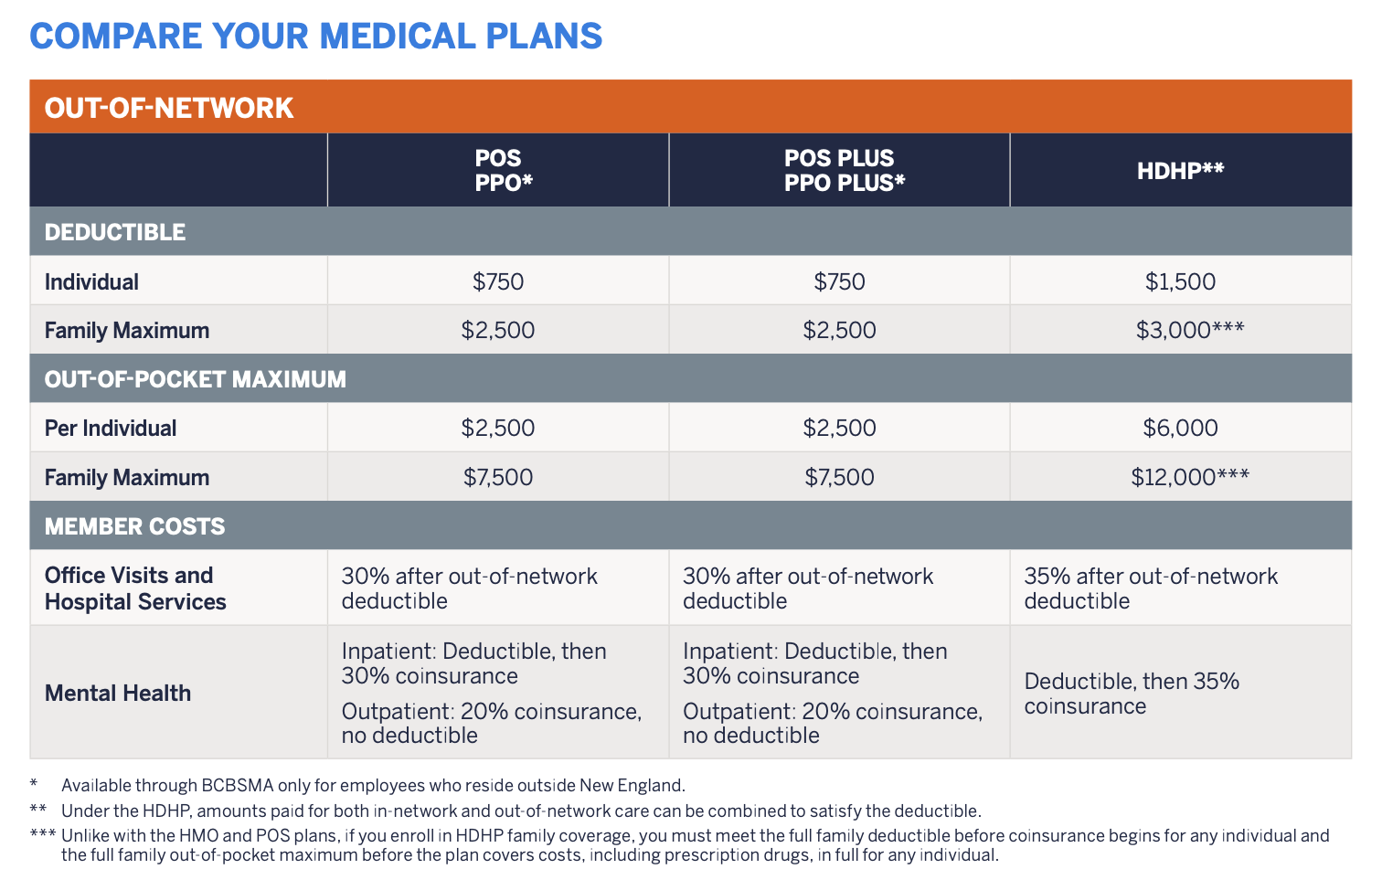
Cost Sharing Details: Out of Network
Key Terms:
Deductible (separate from in network!)
Out-of-Pocket Maximum (separate from in network!)
Notes:
No HMO column: HMO doesn't cover out-of-network care except in certain emergencies
Separate deductible and OOP max from in network: money spent out of network doesn't count toward your in-network deductible (and vice versa)
Exception: under the HDHP, in-network and out-of-network spending combine to meet the deductible
Out-of-network costs are much higher: deductible $750 vs $250 (POS), coinsurance 30% vs 10%
Out-of-network providers have no negotiated price with the insurer and can bill you for the difference between their charge and what the plan pays (balance billing)
Federal No Surprises Act limits this for emergencies and for out-of-network doctors at in-network hospitals
Discussion question: who would pay more for a POS just to get this out-of-network option?
Reasonable answers: People attached to an out-of-network doctor; people who spend time outside the HMO’s area; people with complex or rare conditions who want access to a specific center or expert outside the network

Slide 14
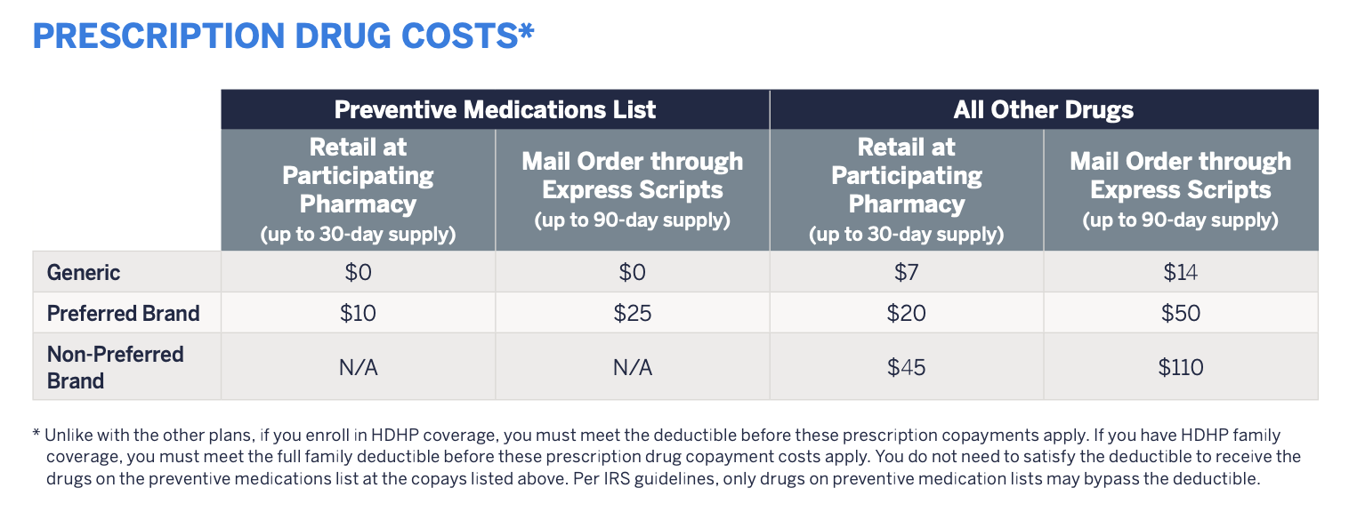
Cost Sharing Details: Prescription Drugs
Key Terms:
Generic
Preferred Brand
Non-Preferred Brand
Mail order
Notes:
Generic: same active ingredient as a brand drug after the patent expires; cheapest tier
Preferred brand: brand drug the plan has negotiated a better price for; middle tier
Non-preferred brand: brand drug without that deal; most expensive tier
Tie to pharma unit: tiers are how insurers steer patients toward cheaper drugs and get leverage to negotiate prices
Preventive medications list: generics free ($0); these drugs are cheaper because the plan wants people to stay on them
Mail order: up to 90-day supply through Express Scripts at about 2x the 30-day copay (≈ 3 months for the price of 2)
Relevant for Lindsey [case on next slide]: her generic allergy drug is $7 under HMO/POS, but full price ($35) under HDHP because she hasn't met her deductible yet

Slide 15
Agenda for section 8
Review of key health insurance terms
Explore Harvard’s open enrollment guide (~30min)
Calculate costs & choose a plan for Lindsey (~15min)
Notes:
Transition: now apply the guide to one person
Keep slides 10–12 up or have students pull up the screenshots while they work

Slide 16
Each small group will have a vignette describing one Harvard employee
Calculate previous year’s medical spending (both premiums and OOP costs)
Discuss what plan you would select for your employee in the upcoming year using the Harvard open enrollment guide

Slide 17
Employee: Lindsey
Lindsey is a 29-year-old woman who lives in Somerville. Her annual salary is $53,000. She is enrolled in the HMO-HUGHP/POS (HUGHP)/HDHP plan. Last year, she required treatment for her long-standing pollen allergy. She also helped a friend move during the summer and shortly afterwards began to experience some intense back pain. Her primary care physician sent her to a specialist, who recommended an MRI. She was diagnosed with a herniated disk, which was treated with a generic painkiller and 10 physical therapy visits.
Pollen Allergy:
  Prescription Drugs, Retail, Generic, 30-day supply (with no insurance: $35)
Herniated Disk:
  PCP Office Visit (with no insurance: $170)
  Specialist Office Visit (with no insurance: $320)
  MRI (with no insurance: $1400)
  Prescription Drugs, Retail, Generic, 14-day supply (with no insurance: $50)
  10 Physical Therapy Visits (with no insurance: $75 each)
Questions:
Calculate the amount Lindsey spends on her premium, out-of-pocket costs, and her total spending.
Which plan should Lindsey pick for next year if she is expected to have the same care then as she had this year?
Notes:
Assigns students in groups [Groups of 3–4; assign each group one plan (HUGHP HMO, HUGHP POS, or BCBSMA HDHP)]
Have them calculate the costs associated that plan for Lindsey.
Ask students first (to make sure they are on the right track):
Which salary tier is Lindsey in: Tier 1, 2, 3, or 4?
Which coverage level: employee only, employee + spouse/domestic partner, employee + child(ren), or family?
Which cost sharing applies: in-network or out-of-network?
Answer: Tier 1, employee only premiums; use in-network cost sharing
Common mistakes to watch for:
Forgetting premiums (monthly × 12) in total spending
Applying a copay AND coinsurance to the same service
Under HDHP, forgetting that office visits and drugs count toward the deductible at full price
Under HDHP, not tracking the running total; once the deductible is met, later services drop to coinsurance or copay
Counting premiums toward the deductible
Work through services in the order they happened (allergy drug → PCP → specialist → MRI → painkiller → PT); under HDHP the order changes the answer slightly

Slide 18
Lindsey’s spending under the HUGHP-HMO plan
Pollen Allergy:
Prescription Drugs, Retail, Generic, 30-day supply (with no insurance: $35) = $7
Herniated Disk:
PCP Office Visit (with no insurance: $170) = $30
Specialist Office Visit (with no insurance: $320) = $30
MRI (with no insurance: $1400) = $250+0.1*$1,150 = $365
Prescription Drugs, Retail, Generic, 14-day supply (with no insurance: $50) = $7
10 Physical Therapy Visits (with no insurance: $75 each) = 10*$30 = $300
Premiums = 12*$89 = $1,068
Cost-Sharing/Out-Of-Pocket = $7 + $30 + $30 + $365 + $7 + $300 = $739
Total = $1,068 + $739 = $1,807
Notes:
Allergy drug: generic, retail, 30-day → $7 copay
PCP and specialist: $30 copay each, regardless of the $170 / $320 price
MRI: high-tech imaging = deductible, then 10% coinsurance. First $250 is the deductible; 10% of the remaining $1,150 = $115 → $365
Painkiller: generic → $7 copay
PT: $30 copay × 10 visits = $300
Premiums: Tier 1, employee only = $89 × 12 = $1,068
OOP $739, well below the $1,500 OOP max
Total $1,807

Slide 19
Lindsey’s spending under the HDHP plan
Pollen Allergy:
Prescription Drugs, Retail, Generic, 30-day supply (with no insurance: $35) = $35
Herniated Disk:
PCP Office Visit (with no insurance: $170) = $170
Specialist Office Visit (with no insurance: $320) = $320
MRI (with no insurance: $1400) = $975+0.15*$425 = $1,038.75
Prescription Drugs, Retail, Generic, 14-day supply (with no insurance: $50) = $7
10 Physical Therapy Visits (with no insurance: $75 each) = 10*$75*0.15 = $112.5
Premiums = 12*$50 = $600
Cost-Sharing/Out-Of-Pocket = $35 + $170 + $320 + $1,039 + $7 + $113 = $1,684
Total = $1,684 + $600 = $2,284
Notes:
Deductible is $1,500; everything she pays counts toward it until she reaches it
Allergy drug: not on preventive list, deductible not met → full price $35 (running total $35)
PCP visit: deductible not met → full price $170 (running total $205)
Specialist: full price $320 (running total $525)
MRI: $975 left on deductible → pays $975, deductible now met; remaining $425 at 15% = $63.75 → $1,038.75
Painkiller: deductible met, so regular generic copay → $7
PT: deductible met → 15% of $750 = $112.50
OOP = $1,683.25 (slide rounds to $1,684); below the $3,000 OOP max
Premiums: $50 × 12 = $600
Total $2,283.25 (slide rounds to $2,284)
Not included: Harvard's HSA contribution, which would lower her effective cost [add 2027 amount]

Slide 20
Lindsey’s spending under the HUGHP-POS plan
Pollen Allergy:
Prescription Drugs, Retail, Generic, 30-day supply (with no insurance: $35) = $7
Herniated Disk:
PCP Office Visit (with no insurance: $170) = $30
Specialist Office Visit (with no insurance: $320) = $30
MRI (with no insurance: $1400) = $250+0.1*$1,150 = $365
Prescription Drugs, Retail, Generic, 14-day supply (with no insurance: $50) = $7
10 Physical Therapy Visits (with no insurance: $75 each) = 10*$30 = $300
Premiums = 12*$129 = $1,548
Cost-Sharing/Out-Of-Pocket = $7 + $30 + $30 + $365 + $7 + $300 = $739
Total = $1,548 + $739 = $2,287
Notes:
Cost sharing is identical to the HMO (same in-network table), so OOP is the same $739
Only difference is premium: $129 × 12 = $1,548
Total $2,287 → Lindsey pays $480 more for an out-of-network option she never used
Discussion question: who would this extra $480 be worth it for?

Slide 21
Lindsey’s spending under 4 different insurance plans
 | Insurance plan
 | Uninsured | HMO (HUGHP) | POS (HUGHP) | HDHP
Premium (Tier 1) | $0 | $1,068 | $1,548 | $600
Generic RX Drugs (Allergy) | $35 | $7 | $7 | $35
PCP visit | $170 | $30 | $30 | $170
Specialist visit | $320 | $30 | $30 | $320
MRI | $1,400 | $365 | $365 | $1039
Generic RX Drugs (Herniated Disk) | $50 | $7 | $7 | $7
Physical therapy | $750 | $300 | $300 | $113
Total Out of Pocket Spending | $2,725 | $739 | $739 | $1,684
Total spending | $2,725 | $1,807 | $2,287 | $2,284
Notes:
HMO is cheapest for Lindsey this year ($1,807)
POS and HDHP end up almost tied (~$2,285), for different reasons: POS has high premiums but low cost sharing; HDHP has low premiums but she paid most of the deductible
Uninsured: $2,725 this year, which is only about $900 more than HMO; worth asking students why this is still a bad deal
Answer: she got lucky; a hospitalization or cancer diagnosis could cost tens of thousands with no cap
Lecture tie-in: top 5% of spenders account for about half of all spending; no one knows in advance if they'll be in that group

Slide 22
Factors to consider when choosing health insurance
Expected value (how much one pays under each plan given current health status or spending)
  Would calculate medical spending based on things you knew were likely to happen (e.g., allergies, diabetes care, etc.)
Uncertainty (how much risk one is willing to bear in each health insurance plan).
  Can not predict all medical care needs (e.g., cold and sinus infection, herniated disk, etc.)
  The plan where you end up spending more compared to other plans may still be optimal, depending on how much protection against risk the plan provides.
Notes:
Two things matter: expected cost and risk
Expected cost: what you'd pay given care you can predict (chronic conditions, regular prescriptions)
Risk: what you'd pay in a bad year. Worst case = premiums + OOP max
Worst case for Lindsey: HMO $1,068 + $1,500 = $2,568; POS $1,548 + $1,500 = $3,048; HDHP $600 + $3,000 = $3,600; uninsured: no limit
HMO wins on both for Lindsey; the tradeoff is the restricted network
HDHP can make sense for someone young and healthy who expects little care, especially with the HSA contribution
Someone very risk-averse may prefer a plan with a higher expected cost but a lower worst case
The plan that cost more this year can still have been the right choice given what you knew at the time you picked it
Preview: if healthy people choose HDHPs and sick people choose richer plans, premiums for the richer plans rise (adverse selection; 11/24 lecture)

